Slide 1
Secure Network Design for SRM
A campus network is an autonomous network under the management of university. An efficient network is essential to facilitate the systematic and cost-efficient transfer of information in the form of messages, files, resources and many more vital data.

Slide 2

Wireless Network
Campus networking via wireless connection has become is an important part of any campus and provides the main way for teachers and students to access educational resources, which gives an important platform to exchange information.
Wireless has many benefits over wired such as
Mobility
Accessibility
Expandability
Guest Access.
As SRM has a whole Wireless Network, so wireless connectivity has been shown to make the network efficient for all kind of devices.

Slide 3
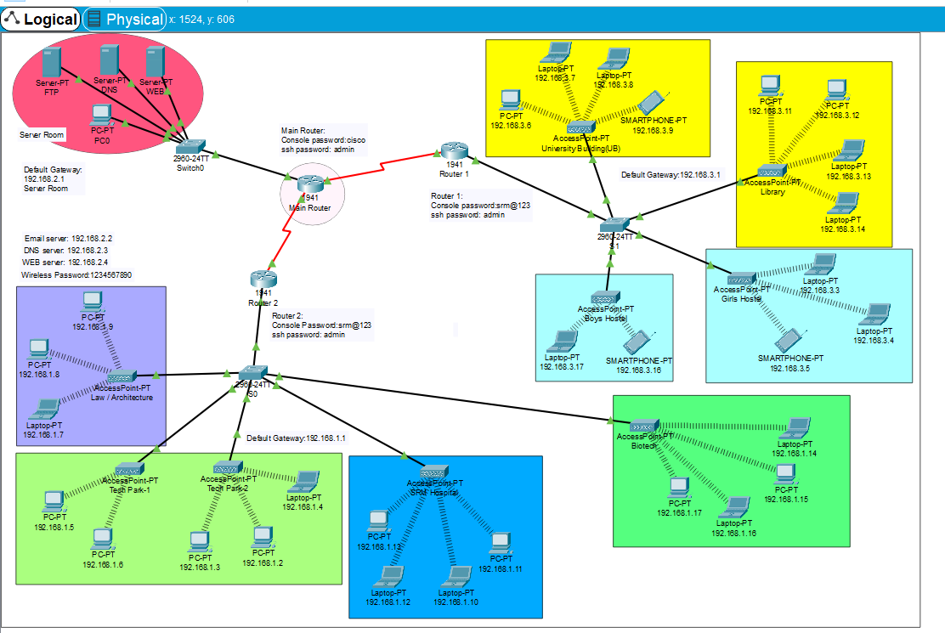
SRM Network Architecture

Slide 4
Topology
The architecture has been displayed in the previous slide.
There is a Server room which is connected through cable with a switch which connects to the main router.
There are 2 more routers.
Router 1 connects the UB, library and the boys girls hostels through access points.
Router 2 connects the Tech Park, Law/Architecture and SRM hospital buildings through with switches.

Slide 5
Devices Used in the project
DNS Server
WEB Server(HTTP)
Email Server
PCs
Router
Switches
Smartphones
Laptops
Access Points(Wireless Device)

Slide 6
DNS Server: DNS stands for Domain Name System servers which are application servers that provide a human-friendly naming method to the user computers in order to make IP addresses readable by users
WEB Server: A web server is a application server that hosts programs and data requested by users across the Internet . Web servers respond to requests from browsers running on client computers for web pages, or other web services.
Email Server: An e-mail server is a server that handles and delivers e-mail over a network, using standard email protocols. For example, the SMTP protocol sends messages and handles outgoing mail requests

Slide 7
Challenges for campus network
Heavy use of NAT and firewalls that limit performance
Network which are not structured properly cannot be effectively utilize with high bandwidth connections
Networks which are built with unmanaged network equipment that provide no ability for monitoring or tuning the network
Slow speed or low Bandwidth due to wireless connection

Slide 8
Security Features
Routers are secured with Secure Shell(ssh)
Secure Shell enables a user to access a remote device and manage it remotely. However, with SSH, all data transmitted over a network is encrypted and secure from eavesdropping.
SSH is a client-server protocol, with an SSH client and an SSH server. The client machine (such as a PC) establishes a connection to an SSH server running on a remote device (such as a router). Once the connection has been established, a network admin can execute commands on the remote device.

Slide 9


Password Protection
Password protection is very important in a network. All the devices are password protected and cannot be accessed without password or authorization.
Passwords are used in accessing the router and all the wireless networks to make the access limited to University authorized users only which includes the students and the faculty.

Slide 10
Virus Protection
Almost all viruses are spread through the actions of users suck as – Clicking “OK” or “Install” when they shouldn’t or opening spam email attachments
Server-based viruses or intrusions are typically caused from attacks on those servers (external to campus, and from users) – Firewalls might help
All devices can be installed with Antivirus Software.

Slide 11

Encryption of Passwords
Encryption is important to prevent eavesdropping and protect sensitive data and to protect passwords.
Clear-text password protocols has been disabled.
Ssh has been used.

Slide 12
Types of attacks expected
Phishing: this is a way of attempting to acquire information such as usernames, passwords and credit card details by masquerading as a trustworthy entity in an electronic communication
Sniffers: this is a program or device that captures the vital information from the network traffic specific to a particular network
Hacking: this is the unauthorized accessing of a computer system for data or information belonging to someone else.
Spamming: this involves populating the inbox of a target group with junk or unsolicited emails
Ddos attacks

Slide 13
Vulnerabilities Expected
Insecure/exposed Ports.
Poor anti-virus implementation.
Downloading of files and applications from sites that are not trusted.
Users fail to give proper attention by refusing to read the warning messages or security indicators.
Carelessness on the path of users

Slide 14
Countermeasures
Keep all your systems up-to-date with patches .
Get rid of old operating systems (like Windows XP) .
Use the security features built into the hosts like use the built- in host-based firewall.
Use strong authentication like SSH authentication.
Use Antivirus Software there are some free antivirus like kaspersky Antivirus

Slide 15
Virtual Private Network(VPN)
Use VPN technology which uses special software on each computer to encrypt network traffic from that computer to a VPN concentrator on the institution’s network.
Firewall
These are programs or hardware devices that protect the resources of a private network from users of other networks. Firewalls are responsible for incoming traffic to be allowed to pass, block or refuse and they also work with proxy servers

Slide 16
Log Analysis
Log analysis is very important
Central syslog server and gather logs from: – DHCP server, DNS servers, Mail servers, switches, routers, etc. So we can find the user from the given IP.
Lots of tools to correlate logs and alarm on critical events

Slide 17
THANK YOU
By:- Rahul Aggarwal(RA1811033010064) of SRMIST
Under the guidance of Venkatesh Sir.

